Slide 1
Making this resource work for you
Prior to teaching this lesson, please refer to the ‘Unit Overview and Planning Document’.
Further guidance on planning Science Mastery lessons can be found in the detailed planning guidance document.
Refer to the ‘notes’ section on each slide for useful information, including suggested expositions, pedagogical content knowledge, suggested questions, answers and more. Consider using presenter mode so you can see this guidance throughout the lesson.
The introduction slides can be adapted to suit your teaching style and the needs of your class.
Before the lesson, adapt the fix-it slide to address any misconceptions identified in the previous lesson’s exit ticket.
Choose from the suggested activities to suit your class. The intention is not that you complete all of these, but that you select those which ones are most appropriate for your students. It may be appropriate to further adapt activities for your students.
These lessons are designed to occupy approximately 1 hour. To adapt for a shorter or longer lesson duration we advise you to adapt the activity section accordingly.
Please consider using the final slide to send feedback about this lesson or examples of PowerPoints that you have adapted to our design team. Your feedback is used to improve Science Mastery for all of our teachers and students. We appreciate all suggestions and comments.
Thank you for reading!
The Science Mastery Team

Slide 2

Taking it Further: Addition Polymerisation
Answer the questions below.
State the general formula of alkenes.
Explain why alkenes are described as unsaturated.
Describe how bromine water could be used to identify an alkene.
Define a polymer.
Explain the difference between thermosetting and thermosoftening polymers.
C_{n}H_{2n}
They contain a C=C double bond
Bromine water would turn from orange to colourless when added to an alkene.
A long molecule made up of many repeating units.
Thermosetting polymers contain crosslinks, so they do not melt when heated. Thermosoftening polymers melt when heated.
Notes:
Big idea: Reactions rearrange matter
Foundation: Name the alkene that contains three carbon atoms.
Stretch: Explain what is meant by crosslinks.
Answers:
Foundation: Propene
Stretch: Covalent bonds between polymer molecules.

Slide 3
Taking it Further: Addition Polymerisation
Do Now:
State the general formula of alkenes.
Explain why alkenes are described as unsaturated.
Describe how bromine water could be used to identify an alkene.
Define a polymer.
Explain the difference between thermosetting and thermosoftening polymers.
Drill:
Draw the displayed formula for ethene.
Draw the displayed formula for butene.
Compare the structure of butene and butane.
Notes:
Drill answers:
Both contain 4 carbon atoms but butene contains 8 hydrogen atoms while butane contains 10 hydrogen atoms. Butene contains a C=C double bond while butane contains only single bonds.

Slide 4
Taking it Further: Addition Polymerisation
Read Now:
Polymers are long molecules made up of repeating units called monomers. One of the most common polymers used by humans is poly(ethene), which is made in both high-density and low-density forms. Poly(ethene) is made through the joining of many ethene monomers, a reaction which is called addition polymerisation. The double bond of the ethene molecules is broken, allowing the carbon atoms to bond with neighbouring molecules. However, it is not just poly(ethene) that can be made through addition polymerisation. Other polymers such as poly(propene) or poly(chloroethene) are also made through addition polymerisation. In addition polymerisation, the only product is the polymer.
Define a polymer.
Identify the monomer that makes up poly(ethene).
Describe how poly(ethene) is formed.
Give an example of another polymer made through addition polymerisation.

Slide 5
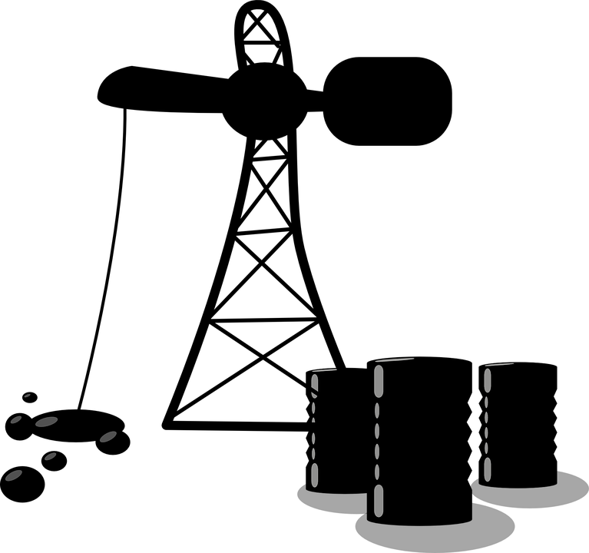
C5.1.13
02/04/2024
Taking it Further: Addition Polymerisation
C5.1.1 Prior Knowledge Review
C5.1.2 Crude Oil and Hydrocarbons
C5.1.3 Fractional Distillation
C5.1.4 Combustion of Hydrocarbons
C5.1.5 Cracking
C5.1.6 Taking it Further: Alkenes
C5.1.7 Taking it Further: Alcohols
C5.1.8 Taking it Further: Producing Ethanol by Fermentation
C5.1.9 Taking it Further: Producing Ethanol from Ethene
C5.1.10 Taking it Further: Carboxylic Acids
C5.1.11 Taking it Further: Esters
C5.1.12 Polymers
C5.1.13 Taking it Further: Addition Polymerisation
C5.1.14 Taking it Further: Condensation Polymerisation
C5.1.15 Taking it Further: Naturally Occurring Polymers
Notes:
Big Idea: Structure Determines Properties
In this lesson, which is for separate science students, students will build on their knowledge of polymers from the previous lesson, linking particularly to the structures of alkenes. In the next lesson, they will look at condensation polymerisation and be able to compare the two processes.
Suggested Hook:
If poly(ethene) is made from ethene monomers, what polymer would be made from chloroethene or bromoethene?

Slide 6

Following this lesson, students will be able to:
Identify monomers used to make given polymers
Describe the process of addition polymerisation
Key Words:
polymer
monomer
poly(ethene)
addition
polymerisation
Notes:
Guidance:
See unit overview document and planning guidance to see how these objectives are typically assessed at GCSE, including examples of what students should be able to do following this lesson.
Planning for different needs:
The learning objectives given on this slide are suggested based on the most common requirements for exams, however they can be adapted based on the needs of different classes.
For best practice, the unit preparation booklet should be used to determine the appropriate focus of lessons within the unit.
While it is not possible to explicitly split content into levelled grades, we recommend that lesson objectives can be classified as critical, core or stretch.
Critical: the content or skill is essential for all students to be able to progress.
Core: the content or skill is important for students to progress, but other opportunities may be available to revisit it.
Stretch: the content or skill may not be essential for all students but is important for students aiming for the highest grades.
Key skill: this is a crucial skill being developed in this unit as part of the skill mapping
C5.1.13 Lesson Objectives:
Critical: Identify monomers used to make given polymers
Core: Describe the process of addition polymerisation

Slide 7
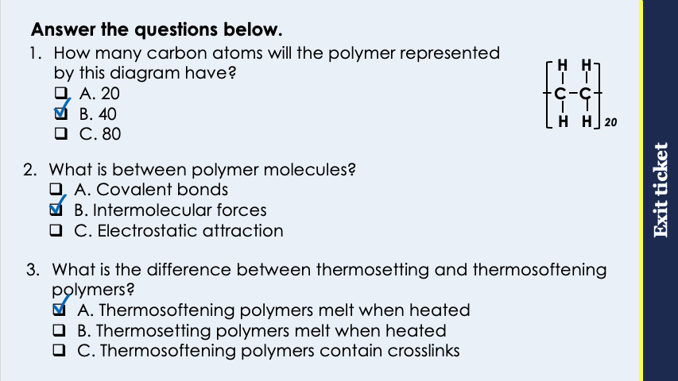
This is the fix-it portion of the lesson
The fix-it is an opportunity to respond to gaps in knowledge, especially those identified by the pre-unit quiz.
The teacher should customise this slide as needed, to facilitate
reteach, explanation, demonstration or modelling of ideas and concepts that students have not yet grasped or have misunderstood.
practise answering specific questions or of key skills.
redrafting or improving previous work.
Notes:
Purpose: to spend time on any gaps identified in previous learning from previous exit ticket.
Guidance from previous exit ticket:
Q1. Answer: B
If students answer A, they have accepted the number ‘n’ as equalling the number of carbon atoms, and disregarded the number of carbons within the brackets. If students answered C, they have calculated the number of hydrogens in the molecule instead. To fix-it, model the correct method of carrying out this calculation and then give students some similar questions to try independently.
Q2. Answer: B
If students answer A, they have made the common mistake of confusing the bonds within molecules with the IMFs between them. If students answer C, they have confused covalent and ionic bonding. To fix it, review the different types of bonding and why covalent molecules have relatively low melting and boiling points but polymers have higher melting and boiling points.
Q3. Answer: A
If students answer B or C, they are not clear on the difference between thermosetting or thermosoftening polymers. To fix it, review the structure of each and how this affects their properties.

Slide 8
Addition Polymerisation
H H
H H
H H
H H
H H
H H
H H
H H
C C
+
C C
+
C C
+
C C
→
C C
C C
C C
C C
H H
H H
H H
H H
H H
H H
H H
H H
In addition polymerisation, monomers are added together to form a polymer.
For example: Ethene monomers are added together to make poly(ethene)
The polymer contains all the atoms of the monomers, so there are no other products.
Notes:
Suggested exposition:
In the last lesson we looked at the definition on a polymer.
What is a polymer?
A long molecule made of repeating units (called monomers).
In this lesson, we’re going to look at how polymers are actually formed from monomers.
Animate slide.
This process shows addition polymerisation.
What does addition mean?
When things are added joined together.
That’s exactly what happens in addition polymerisation. The monomers are added together to form the polymer.
Alkenes can be used to make polymers addition polymerisation.
What is the monomer here?
Ethene.
Lots of ethene molecules are joined together to make a polymer called (polyethene). This works with alkenes because they are unsaturated.
What does this mean?
They contain a C=C double bond.
It is this C=C double bond that is responsible for this polymerisation reaction. The double bond in each small ethene molecule is broken open, leaving each of the carbon atoms free to bond to a carbon atom from a neighbouring molecule. This process can be repeated many, many times to make a very long polymer.
How do the atoms compare in the reactants (the monomers) and the product (the polymer)?
They are the same.
In an addition polymerisation reaction, the monomers are simply added together to form the polymer. There are no other products.

Slide 9
Addition Polymerisation
H H
H H
H H
H H
H H
H H
C C
+
C C
+
C C
→
C C
C C
C C
CH₃ H
CH₃ H
CH₃ H
CH₃ H
CH₃ H
CH₃ H
Propene monomers
Poly(propene) polymer
Notes:
Suggested exposition:
Other alkenes can also undergo addition polymerisation, for example propene monomers can be joined together to form poly(propene).
Animate the monomers.
How can you tell these monomers are propene?
Each molecule contains three carbon atoms and a C=C double bond.
We draw them in this way as it is the double bond that allows them to undergo the polymerisation reaction. The rest of the chain (the CH₃ group) is not involved in the reaction.
How can you tell addition polymerisation is a chemical reaction?
A new product has formed.

Slide 10

Can you explain the difference between these two terms?
Monomer
What are the reactants and products of an addition polymerisation reaction?
What is the relative size of each?
Which contains a double bond?
How do we write the names of each?
Polymer
Notes:
Suggested guidance:
Talk tasks can be used in a variety of ways to suit the particular needs of the students you are teaching. Through exchanging views with others, students develop their understanding of the science beyond what could be achieved individually.
Science classrooms that successfully integrate talk have the following features:
Science talk is a regular feature of lessons and is woven into classroom activities.
Students are paired or grouped strategically by the teacher to ensure productive interaction. This might take into consideration the students’ proficiency of the English language, how encouraging they might be to peers and their attainment in the topic. It’s a good idea to consider these pairings in the class seating plan.
Students are encouraged and supported to talk, but are not forced to talk.
The teacher should take on the role of a facilitator, engaging with conversations where necessary and encouraging or steering the conversation where needed.
Students are encouraged to use the language they have to express their ideas (e.g., everyday language, imperfect English, native language), but also to incorporate science specific terminology where this is more accurate or has been taught.
6. Scientifically inaccurate ideas are not dismissed by the partner or teacher; open discussion and further investigation are relied on to help students construct ideas that support them to progress in their scientific understanding.
7. Guidelines for behaviour during talk tasks are explicit and frequently reviewed. Rules for students might be:
Listen carefully to your partner
Take turns talking.
Speak one at a time, without interrupting.
Politely agree or disagree and explain why.
Politely point out if your partner has used a scientific word incorrectly, if they have explained the science incorrectly, or if there is a more accurate way to describe something.
If confused, ask questions.
Stay focused on the discussion topic.
Respond to one another.

Slide 11
Why is this called polyethene not polyethane?
H H
H H
H H
H H
C C
C C
C C
C C
H H
H H
H H
H H
Notes:
This is one of the most common errors that students make in exams. The recognise that it has single bonds and therefore assume it is an alkane rather than an alkene.
The key point to emphasise is that the name of the polymer comes from the name of the monomer, and an alkane could not be a monomer as it does not have the double bond so could not be added to other molecules.
Suggested guidance:
Talk tasks can be used in a variety of ways to suit the particular needs of the students you are teaching. Through exchanging views with others, students develop their understanding of the science beyond what could be achieved individually.
Science classrooms that successfully integrate talk have the following features:
Science talk is a regular feature of lessons and is woven into classroom activities.
Students are paired or grouped strategically by the teacher to ensure productive interaction. This might take into consideration the students’ proficiency of the English language, how encouraging they might be to peers and their attainment in the topic. It’s a good idea to consider these pairings in the class seating plan.
Students are encouraged and supported to talk, but are not forced to talk.
The teacher should take on the role of a facilitator, engaging with conversations where necessary and encouraging or steering the conversation where needed.
Students are encouraged to use the language they have to express their ideas (e.g., everyday language, imperfect English, native language), but also to incorporate science specific terminology where this is more accurate or has been taught.
6. Scientifically inaccurate ideas are not dismissed by the partner or teacher; open discussion and further investigation are relied on to help students construct ideas that support them to progress in their scientific understanding.
7. Guidelines for behaviour during talk tasks are explicit and frequently reviewed. Rules for students might be:
Listen carefully to your partner
Take turns talking.
Speak one at a time, without interrupting.
Politely agree or disagree and explain why.
Politely point out if your partner has used a scientific word incorrectly, if they have explained the science incorrectly, or if there is a more accurate way to describe something.
If confused, ask questions.
Stay focused on the discussion topic.
Respond to one another.

Slide 12
Drill
Define a polymer.
Define a monomer.
Describe what happens during an addition polymerisation reaction.
Identify the product(s) that are formed in an addition polymerisation reaction.
Ethene molecules join to form poly(ethene). Identify the monomer and the polymer.
Name the polymer that would be formed through addition polymerisation of propene molecules.
Name the monomer that would have been used to form the polymer poly(butene).
Notes:
Purpose: This is a knowledge drill. The purpose of this is to check that the critical knowledge is secure before pupils move onto independent practice.
Suggested guidance: There are a range of ways this could be done depending on time and ability range of the class:
Mini whiteboards
As full sentences in exercise books
As short answers in exercise books
In the pupil workbook
As pair talk
As cold call

Slide 13
Drill answers
Long chain molecules made of many units
Small molecules that can be joined together to make a polymer.
Monomers are joined together when their double bonds are broken.
Only a polymer is formed
Ethene is the monomer and poly(ethene) is the polymer.
Poly(propene)
Butene
Notes:
Purpose: This is a knowledge drill. The purpose of this is to check that the critical knowledge is secure before pupils move onto independent practice.
Suggested guidance: There are a range of ways this could be done depending on time and ability range of the class:
Mini whiteboards
As full sentences in exercise books
As short answers in exercise books
In the pupil workbook
As pair talk
As cold call

Slide 14
I: Identifying monomers
The displayed formula below shows part of a polymer.
Draw the displayed formula of the monomer.
H Cl
H Cl
H Cl
H Cl
H Cl
C C
C C
C C
C C
C C
H H
H H
H H
H H
H H
1. Identify the repeating unit
2. Draw the structure of the repeating unit
3. Replace the double bond that was broken during polymerisation
Notes:
Purpose: The I-We-You section aims to support pupils to build skills that they most commonly need when answering questions associated with this knowledge in the assessment. This section is also used to interleave other content we expect pupils to know at this stage of their education in order that they build a big picture of the science they are learning.
For the ‘I’ activity, the teacher should model how to answer the question. They can do this by narrating their thinking process aloud, and making links to learning earlier in the lesson explicit.
For the ‘we’ activity, the teacher and students work though a similar example together, in order to prepare students to be able to answer a similar question independently.
Opportunities for the ‘you’ activity – independent practise – occur in the activity portion of the lesson once the student is secure enough to process independently.

Slide 15
We: Identifying monomers
The displayed formula below shows part of a polymer.
Draw the displayed formula of the monomer.
Br H
Br H
Br H
Br H
Br H
C C
C C
C C
C C
C C
H CH₃
H CH₃
H CH₃
H CH₃
H CH₃
1. Identify the repeating unit
2. Draw the structure of the repeating unit
3. Replace the double bond that was broken during polymerisation
Notes:
Purpose: The I-We-You section aims to support pupils to build skills that they most commonly need when answering questions associated with this knowledge in the assessment. This section is also used to interleave other content we expect pupils to know at this stage of their education in order that they build a big picture of the science they are learning.
For the ‘I’ activity, the teacher should model how to answer the question. They can do this by narrating their thinking process aloud, and making links to learning earlier in the lesson explicit.
For the ‘we’ activity, the teacher and students work though a similar example together, in order to prepare students to be able to answer a similar question independently.
Opportunities for the ‘you’ activity – independent practise – occur in the activity portion of the lesson once the student is secure enough to process independently.

Slide 16
You: Identifying monomers
The displayed formula below shows part of a polymer.
Draw the displayed formula of the monomer.
Cl H
Cl H
Cl H
Cl H
Cl H
C C
C C
C C
C C
C C
C₂H₅ H
C₂H₅ H
C₂H₅ H
C₂H₅ H
C₂H₅ H
1. Identify the repeating unit
2. Draw the structure of the repeating unit
3. Replace the double bond that was broken during polymerisation
Notes:
Purpose: The I-We-You section aims to support pupils to build skills that they most commonly need when answering questions associated with this knowledge in the assessment. This section is also used to interleave other content we expect pupils to know at this stage of their education in order that they build a big picture of the science they are learning.
For the ‘I’ activity, the teacher should model how to answer the question. They can do this by narrating their thinking process aloud, and making links to learning earlier in the lesson explicit.
For the ‘we’ activity, the teacher and students work though a similar example together, in order to prepare students to be able to answer a similar question independently.
Opportunities for the ‘you’ activity – independent practise – occur in the activity portion of the lesson once the student is secure enough to process independently.

Slide 17
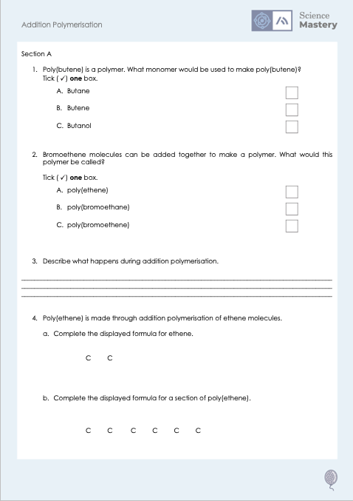
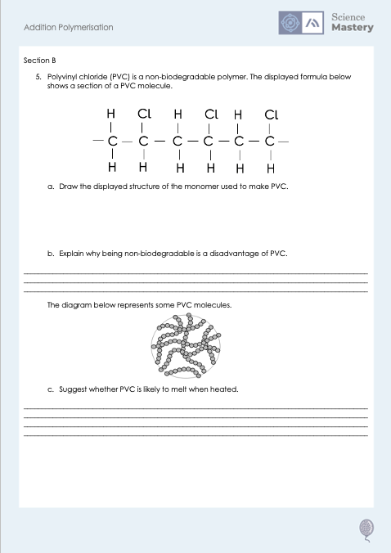
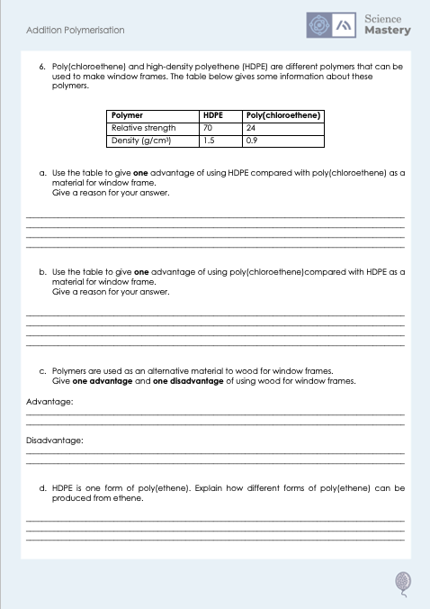
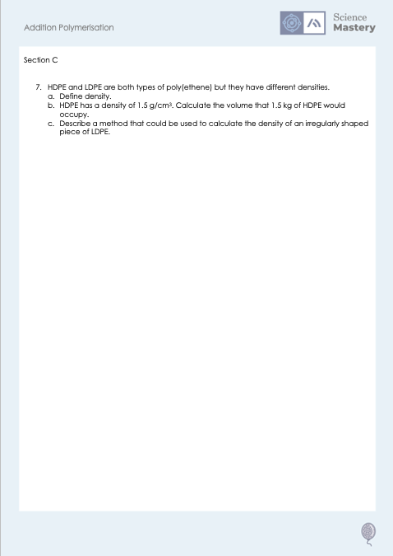
Worksheet

Slide 18
Answers
1. B - Butene
2. C - Poly(bromoethane)
3. Double bonds in monomer units break open so they can join together to form a polymer
4a.
H H
4b.
H H
H H
H H
C C
C C
C C
C C
H H
H H
H H
H H

Slide 19
Answers
5a.
H Cl
C C
H H
5b. Any one from:
Does not decompose
Would take up space in landfill
Takes up space of habitats
May be eaten/cause harm to animals
5c. It would melt when heated as it is a thermosoftening polymer because it does not contain crosslinks (so little energy would be required to overcome the intermolecular forces).

Slide 20
Answers
6a. It is stronger, so it is less likely to be damaged (or more likely to last longer).
6b. It has a lower density, so would be lighter/easier to install.
6c.
Advantage: Wood is renewable/can be replanted(polymers are not as they come from crude oil)
Disadvantage: Wood may not last as long as it may start to be broken down
6d. Using different reaction conditions (different temperatures or pressures)

Slide 21
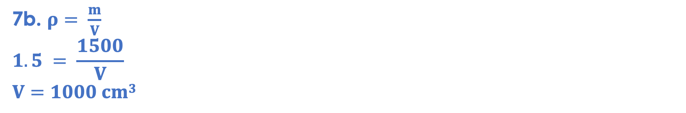
Answers
7a. The mass per unit volume.
7b. $ρ= \frac{m}{V}$
$$1.5 = \frac{1500}{V}$$
$$V=1000 cm3$$
7c.
Measure the mass using a mass balance
Measure the volume using a displacement cylinder/Eureka can full of water
Add the object to the Eureka can and measure the volume of water displaced, which is the volume of the object
Use mass/volume to calculate density

Slide 22
Answer the questions below.
What is the name of the polymer formed through the addition polymerisation of propene?
A. Poly(ethene)
B. Poly(propene)
C. Poly(propane)
✓
What happens to the atoms of monomers in addition polymerisation?
A. Some atoms are lost
B. Extra atoms are produced
C. Atoms are not lost or produced
✓
What is made during an addition polymerisation reaction?
A. A polymer and another product
B. A polymer and different monomers
C. A polymer only
✓
Notes:
Q1. Answer: B
If students answer A, they have just assumed that poly(ethene) is the general polymer rather than a specific polymer. If students answer C, they have not identified the importance of the monomer being an alkene. To fix-it, give students practice naming polymers from monomers and explain why alkanes cannot be monomers.
Q2. Answer: C
If students answer A, they have made the common mistake of confusing bonds being broken with atoms being lost. If students answer B, they have not understood that the atoms themselves do not change, they are simply rearranged. To fix it, review what happens during addition polymerisation and explain why it can be described as a chemical reaction.
Q3. Answer: C
If students answer A or B, they are not clear that addition polymerisation only produces a polymer. This will be revisited in the next lesson where students will compare the processes of addition and condensation polymerisation. To fix it, review what happens during addition polymerisation.

Slide 23
Lesson C5.1.13
What was good about this lesson? | What can we do to improve this lesson?
Send us your feedback by clicking this link
or by emailing sciencemastery@arkonline.org
Thank you!

